Slide 1
Feminist Values in “The Scarlet Letter”
.
Sexual Double Standards
Female Autonomy and Strength
Motherhood
and
Women
Critique of Patriarchal Hypocrisy

Slide 2
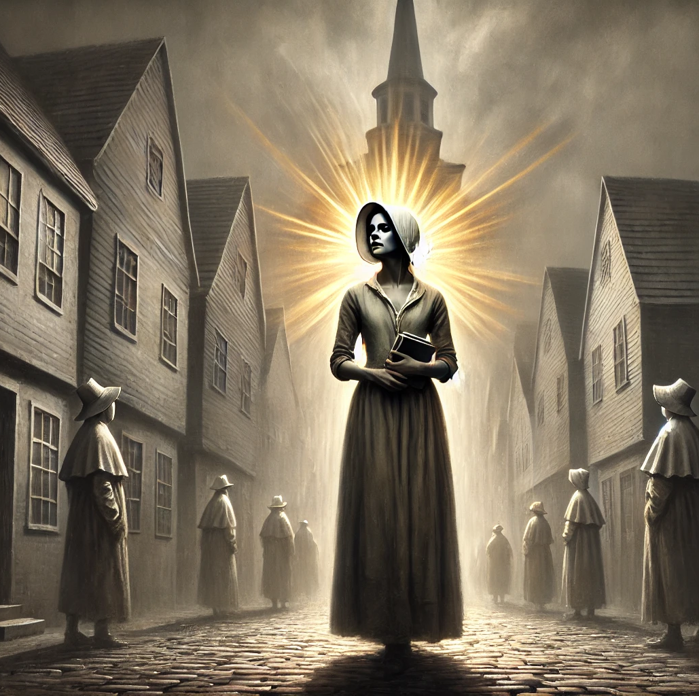
Female Autonomy and Strength
“She had wandered, without rule or guidance, in a moral wilderness; as vast, as intricate, and shadowy, as the untamed forest.”
“The world’s law was no law for her mind.”

Slide 3
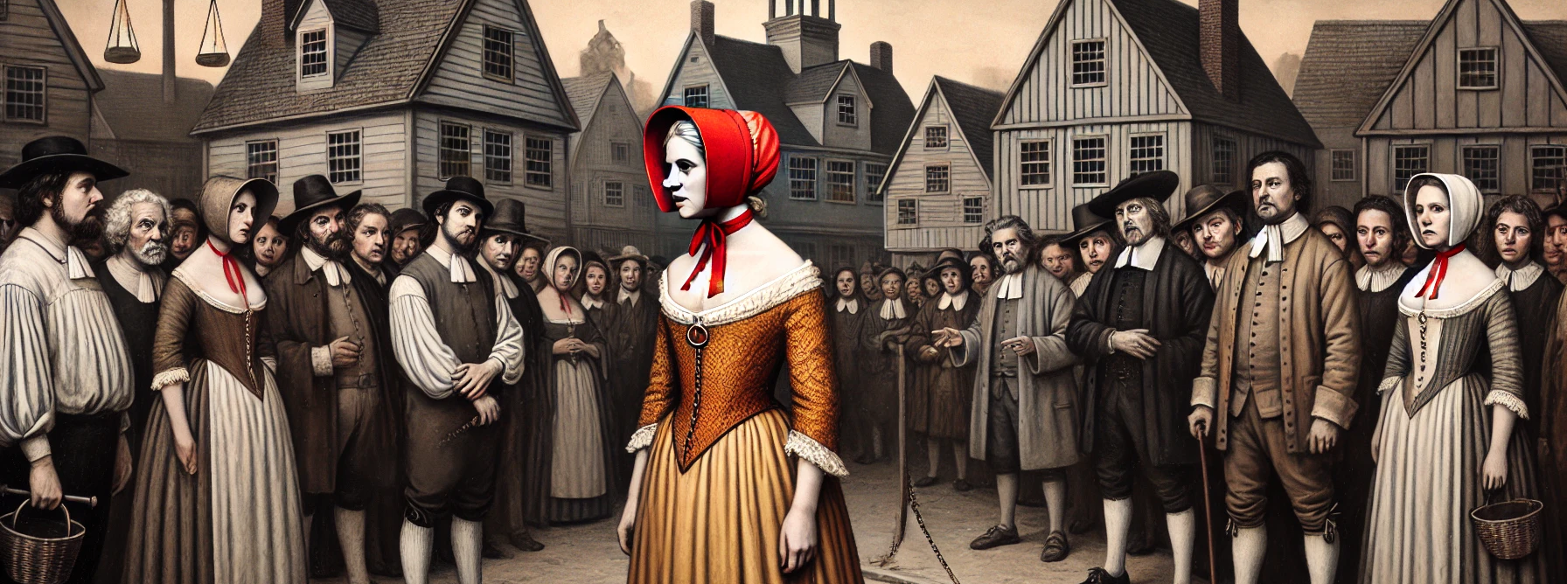
Sexual Double Standards
“Happy are you, Hester, that wear the scarlet letter openly upon your bosom! Mine burns in secret!”

Slide 4
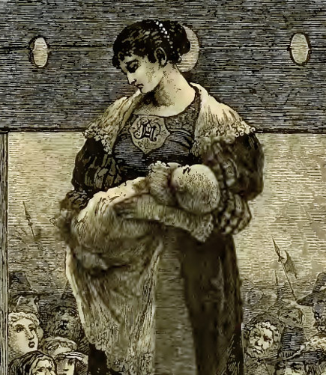
Critique of Patriarchal Hypocrisy
“It was better to accept the penalty of their transgression than to hide a guilty heart through life.”
“It irks me, nevertheless, that the partner of her iniquity should not, at least, stand on the scaffold by her side.”

Slide 5
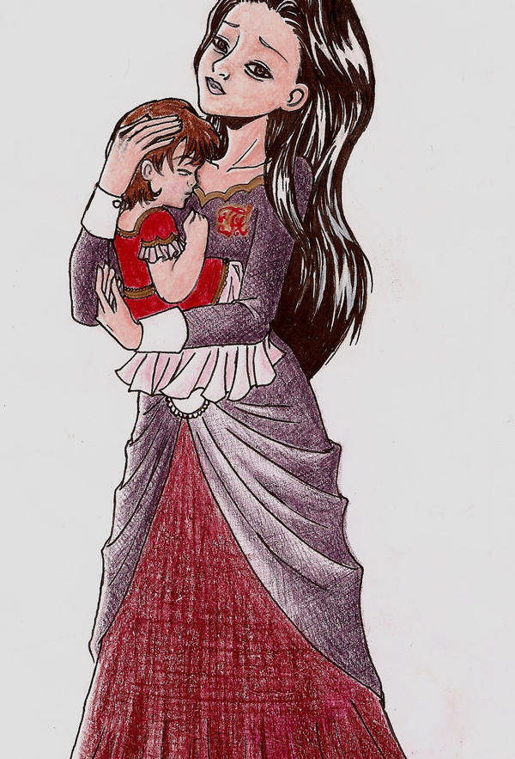
Motherhood and Women
“The mother’s impassioned state had been the medium through which were transmitted to the unborn infant the traits of character she would thereafter develop.”

